Slide 1
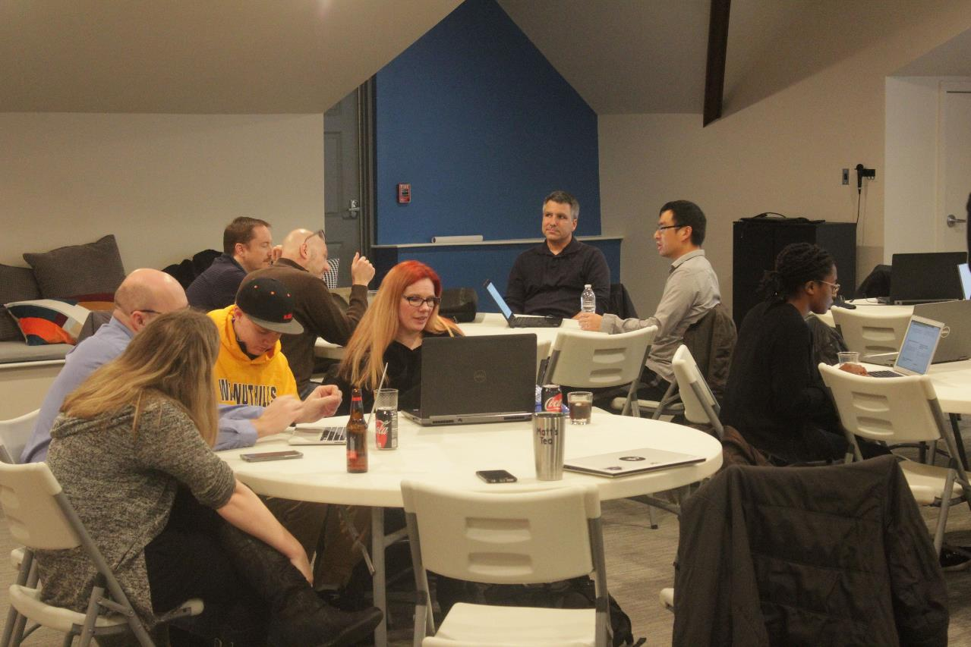
Code, Craft, Community
8/21/2024

Slide 2
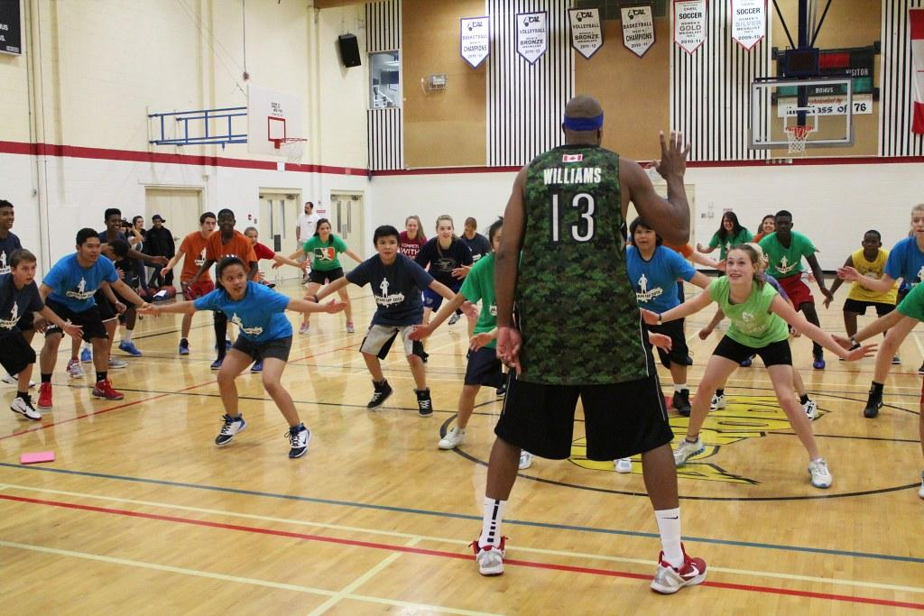
Notes:
Practice

Slide 3
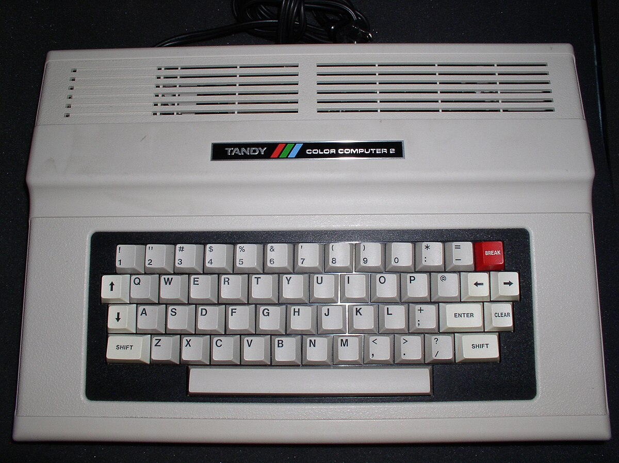
Notes:
Technology Agnostic

Slide 4

Notes:
Better together

Slide 5

Notes:
Point at code

Slide 6

Notes:
write code

Slide 7
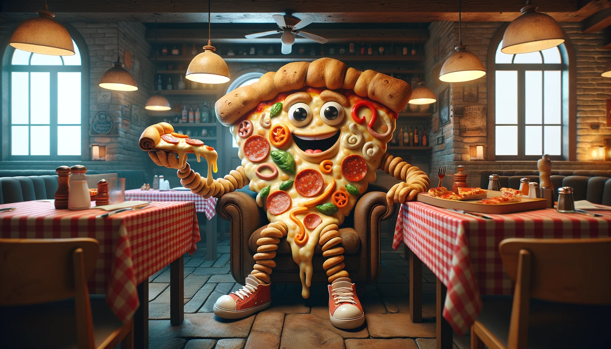
Notes:
pizza

Slide 8

Notes:
raffle

Slide 9

Southwest Ohio GiveCamp
Friday, October 11 – Sunday, October 13, 2024
Miami University VOA Learning Center
https://southwestohiogivecamp.org/

Slide 10

Momentum Developer Conference
Thursday, October 17, 2024
Hard Rock Casino
https://momentumdevcon.com/

Slide 11


What is Caching?

Slide 12
What is Caching?
Caching is a way to improve performance and efficiency of systems
Frequently-accessed data is stored in a temporary area
Temporary area is “closer” to the application, and is faster than the original source

Slide 13
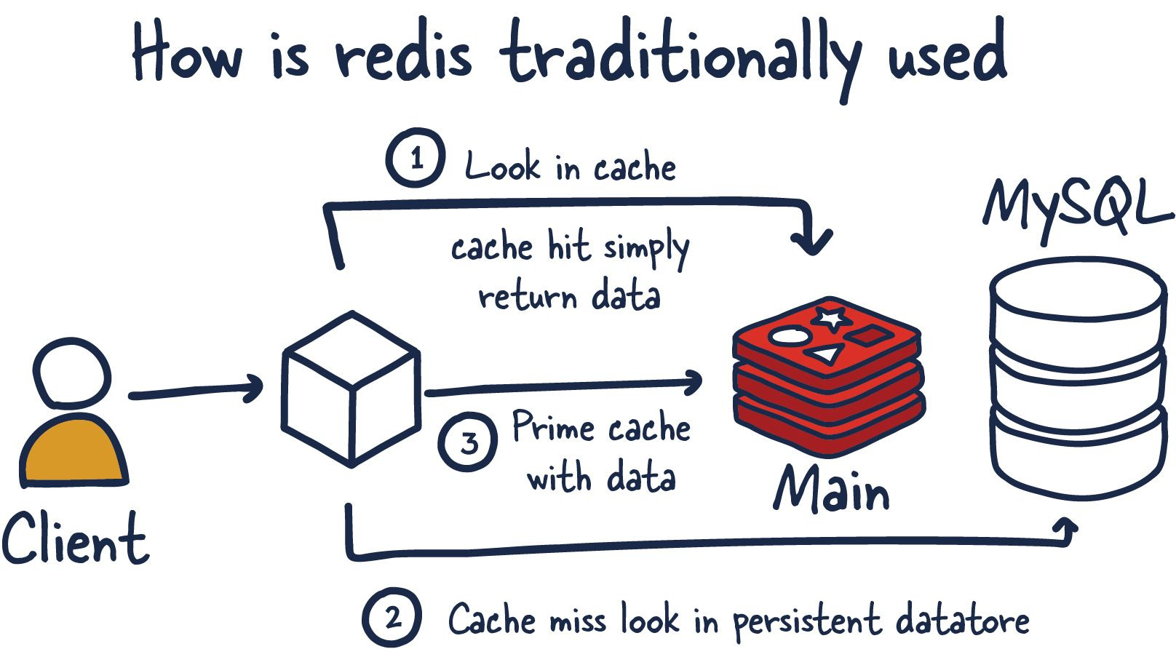
Example – Redis Cache
Credit: https://architecturenotes.co/p/redis

Slide 14
Downsides?
Stale Data
Frequently Changing Data
Limited Cache Size
Security Concerns
Resource Constraints and System Complexity

Slide 15
Downsides?
It is often said that there are only two hard problems in computer science:
Naming Things
Cache Invalidation
Off-by-one Errors

Slide 16
FIFO (First In, First Out) Cache
First items in the cache (oldest) are removed to make room for newer items
Simple implementation (Queue data structure)
Common in applications like web browsers
One
One
Two
Two
Two
add(4)
Two
Three
Three
Three
Three
Four

Slide 17
LIFO (Last In, First Out) Cache
Last items in the cache (newest) are removed to make room for newer items
Simple implementation (Stack data structure)
Common in functions like undo/redo
One
One
One
One
Two
add(4)
Two
Two
Two
Three
Three
Four

Slide 18
LRU (Least Recently Used) Cache
Like FIFO, but when an item is accessed (retrieved or updated), it is moved to the bottom, so that it is the “newest”
More complex implementation, must keep track of order of access
Could be a Queue, but need to manipulate it when items are accesed
Common in applications like databases and web servers
One
Two
Two
Three
Two
get(1)
Three
add(4)
Three
One
Three
One
One
Four

Slide 19
LFU (Least Frequently Used) Cache
Like LRU, but when an item is accessed (retrieved or updated), its access count is incremented
More complex implementation, must keep track of frequency of access, possibly time of access as well
Common in applications like CDNs
One : 1
Two : 1
Two : 1
Four : 1
Two : 1
get(1)
Three : 1
get(3)
One : 2
add(4)
One : 2
Three : 1
One : 2
Three : 2
Three : 2

Slide 20
Wifi Password: ComeJoinUs2!
https://github.com/Ingage-Meetup/20240821-caching

Slide 21

Discord Server
https://discord.gg/Bn7wVwH4m4

Slide 22

Handy QR Codes

Slide 23
Raffle
A Jetbrains license, good for any of their IDEs (IntelliJ, WebStorm, etc.) for one year. It is a “perpetual fallback license”, meaning you can continue to use the version of the IDE that was activated, even after the year has passed and the license is expired.
Winners, talk to Jim Kriz, who will send you a PDF with details to redeem your license.
Notes:
Suppose you're on a game show, and you're given the choice of three doors: Behind one door is a car; behind the others, goats. You pick a door, say No. 1, and the host, who knows what's behind the doors, opens another door, say No. 3, which has a goat. He then says to you, "Do you want to pick door No. 2?" Is it to your advantage to switch your choice?

Slide 24
As developers we are:
…deliberately trying to get better
…not focused on any particular stack, vendor, or language
…better as a group
…here to write code, think about code, discuss the craft
…dreaming of eating pizza together

